Slide 1
Unit 3 Capstone:
Young Adult Lifestyle Preferences for Fiction Writers
Michael J. Kessler
Unit 3 Capstone

Slide 2

Unit 3 Capstone: Young People Survey
Michael J. Kessler
The Customer
The Dataset
The Question
The Method
The Conclusion
Q&A

Slide 3
The Customer:
First, some background
Young adult fiction writer (any medium)
Creating youth characters can be particularly difficult:
  Lacking in adequate examples
  Memory of youth insufficient or gapped
The verisimilitude is in the details
  What are they like and equally important…
  What AREN’T they like
Deliverable is a predictive model based on key attributes

Slide 4
The Dataset:
Young People Survey
1010 respondents to a 150 question survey
Mostly Likert Scale questions
Subjects Include:
  Music Preferences
  Movie Preferences
  Hobbies & Interests
  Phobias
  Health Habits
  Personality Traits, Views on Life, & Opinions
  Spending Habits
  Demographics
I always give to charity | I have lots of friends | Do you lie to others?
3 | 1 | Sometimes
2 | 4 | Only to avoid hurting someone
5 | 2 | Everytime it suits me

Slide 5
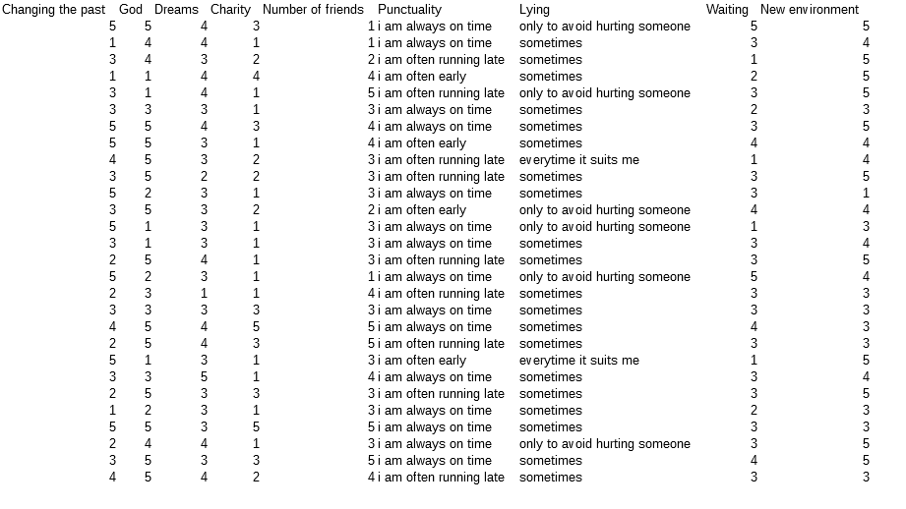

Slide 6
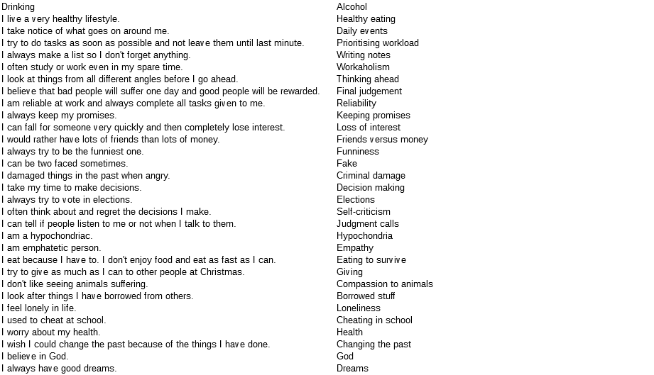

Slide 7

The Question(s)
What are the interests of today’s youth?
What do they think about themselves?
Are these reliably predictable for specific ages relative to other ages?

Slide 8
Preprocessing
Adequate Features
Adequate Observations
Useless Data
  Not informative (Handedness) or informative but not useful (Education)
Categorical Values
  Only 11 features with categorical data
    Some of those binary (gender, only child, handedness)
    Most with fewer than five values
Missing Data
  ~1000 observations with >300 missing some data in 150 features
  Removed useless features first so as not to drop rows unnecessarily
  Imputation over dropping
    most_frequent so not to create non whole numbers for Likert scale values
    More effective than rounding

Slide 9
Preprocessing (continued)
Class Imbalance
  Age imbalances were a serious issue
  Most observations were for ages 18-22
  Used upsampling to even the amounts of observations
Multicollinearity
  No highly correlated features according to heatmap and .corr() review
  Catch 22 – If I remove the features that are correlated I may be able to predict the age more accurately. But I lose the value of those features, which is the overall point of the model. But if I leave them in I create
Outliers
  Not a concern. 5-point Likert Scale or categorical data with few exceptions
  Age restricted to 15 to 30
  Number of siblings not a significant feature - omitted

Slide 10
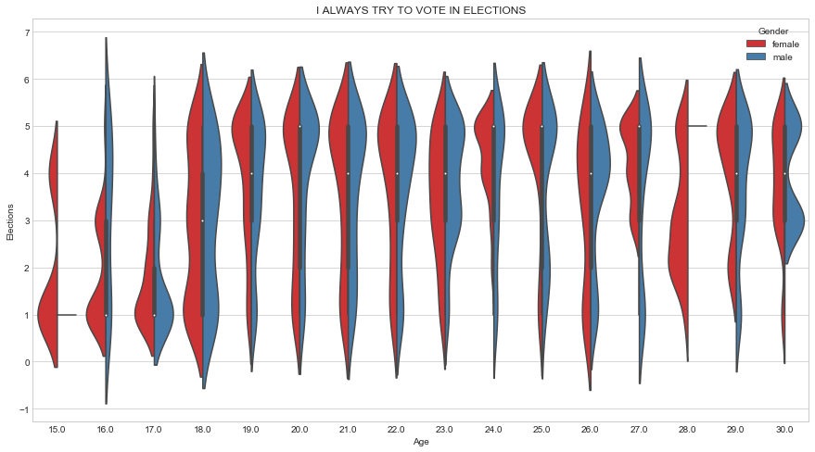
Question-specific Visualizations

Slide 11
Model Selection
Naïve Bayes – Assumption of independence, continuous features
Ordinary Least Squares
KNN
Random Forest – Good model, but we need to interpret the results
Ridge Regression – Don’t want our coefficients penalized (try it anyway)
Lasso Regression – Don’t want our features shrunk
SVM
Gradient Boosting

Slide 12
Model Performance (R-squared score)
OLS – 64.96%
Ridge Regression – 69.96%
KNN Regression – 73.76%
  Best score using 2 neighbors
  PCA score – 88.74
    But what use is the score if PCA renders our features indescribable?
SVM – 85.97%
Gradient Boosting – 90.27%!
  As expected, this was the best performer
Ordinary Least Squares | 65%
Ridge Regression | 70%
KNN Regression | 74%
KNN Regression (PCA) | 89%
Support Vector Machine | 86%
Gradient Boosting | 90%

Slide 13
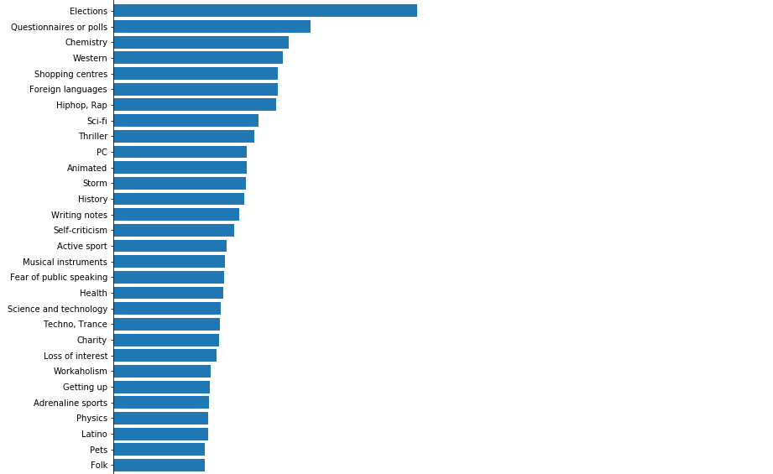
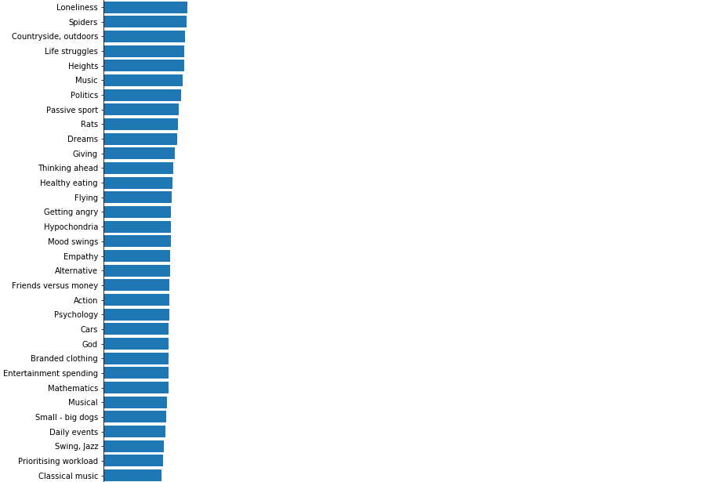
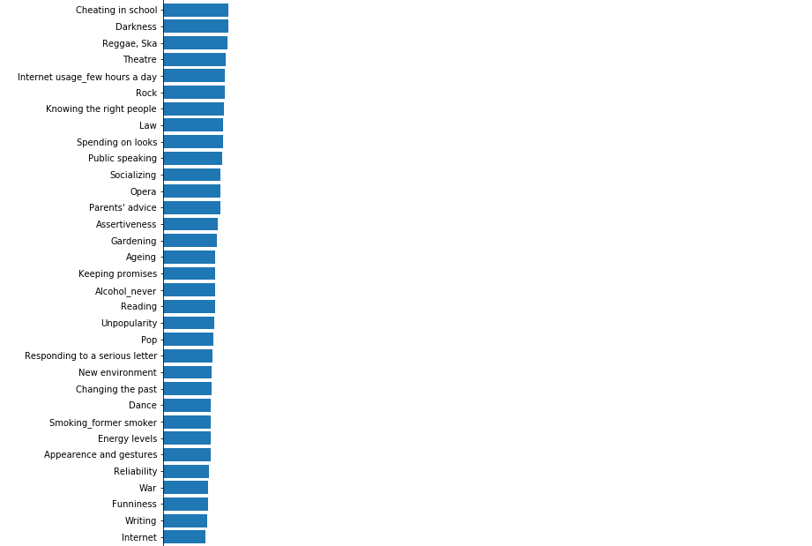
Feature Importance

Slide 14
Classification prediction through response fabrication
Survey Question | Mean | Mode | Survey Question | Mean | Mode | Survey Question | Mean | Mode | Survey Question | Mean | Mode
Music | 4.66 | 5 | Animated | 3.52 | 5 | Active sport | 2.84 | 5 | Reliability | 3.72 | 4
Slow songs or fast songs | 3.21 | 3 | Documentary | 3.42 | 4 | Gardening | 1.62 | 1 | Keeping promises | 3.86 | 4
Dance | 2.85 | 3 | Western | 1.85 | 1 | Celebrities | 2.02 | 1 | Loss of interest | 2.34 | 1
Folk | 2.01 | 2 | Action | 3.26 | 5 | Shopping | 2.97 | 3 | Friends versus money | 3.56 | 5
Country | 1.87 | 2 | History | 2.91 | 3 | Science and technology | 2.92 | 3 | Funniness | 3.06 | 3
Classical music | 2.65 | 3 | Psychology | 2.84 | 3 | Theatre | 2.68 | 3 | Fake | 1.89 | 2
Musical | 2.44 | 3 | Politics | 2.25 | 2 | Fun with friends | 4.48 | 5 | Criminal damage | 2.16 | 1
Pop | 3.23 | 4 | Mathematics | 1.96 | 1 | Adrenaline sports | 2.55 | 3 | Decision making | 2.93 | 3
Rock | 3.51 | 5 | Physics | 1.75 | 1 | Pets | 2.86 | 5 | Elections | 2.92 | 5
Metal or Hardrock | 1.98 | 1 | Internet | 4.05 | 5 | Flying | 1.75 | 1 | Self-criticism | 3.32 | 5
Punk | 2.10 | 1 | PC | 2.80 | 3 | Storm | 1.69 | 1 | Judgment calls | 3.84 | 5
Hiphop, Rap | 2.53 | 4 | Economy Management | 2.28 | 1 | Darkness | 1.93 | 1 | Hypochondria | 1.63 | 1
Reggae, Ska | 2.47 | 3 | Biology | 2.29 | 2 | Heights | 2.27 | 2 | Empathy | 3.63 | 5
Swing, Jazz | 2.43 | 3 | Chemistry | 1.80 | 1 | Spiders | 2.36 | 1 | Eating to survive | 1.92 | 1
Rock n roll | 2.85 | 3 | Reading | 2.72 | 5 | Snakes | 2.58 | 5 | Giving | 2.64 | 3
Alternative | 2.47 | 3 | Geography | 2.76 | 3 | Rats | 2.01 | 1 | Compassion to animals | 3.72 | 5
Latino | 2.50 | 2 | Foreign languages | 3.55 | 5 | Ageing | 2.19 | 1 | Borrowed stuff | 3.83 | 5
Techno, Trance | 1.98 | 1 | Medicine | 2.14 | 1 | Dangerous dogs | 2.67 | 3 | Loneliness | 2.64 | 3
Opera | 1.84 | 1 | Law | 1.94 | 1 | Fear of public speaking | 2.50 | 3 | Cheating in school | 3.48 | 5
Movies | 4.54 | 5 | Cars | 2.27 | 1 | Smoking |  | tried smoking | Health | 3.03 | 3
Horror | 2.39 | 1 | Art exhibitions | 2.24 | 1 | Alcohol |  | social drinker | Changing the past | 2.63 | 3
Thriller | 3.11 | 4 | Religion | 1.92 | 1 | Healthy eating | 2.85 | 3 | God | 2.87 | 5
Comedy | 4.40 | 5 | Countryside, outdoors | 3.42 | 5 | Daily events | 2.84 | 3 | Dreams | 3.22 | 3
Romantic | 3.23 | 3 | Dancing | 2.05 | 1 | Prioritising workload | 2.34 | 3 | Charity | 1.86 | 1
Sci-fi | 2.78 | 3 | Musical instruments | 1.88 | 1 | Writing notes | 2.69 | 5 | Number of friends | 3.14 | 3
War | 2.81 | 3 | Writing | 1.57 | 1 | Workaholism | 2.68 | 3 | Punctuality |  | I am always on time
Fantasy/Fairy tales | 3.51 | 5 | Passive sport | 3.01 | 5 | Thinking ahead | 3.19 | 3 | Lying |  | sometimes

Slide 15
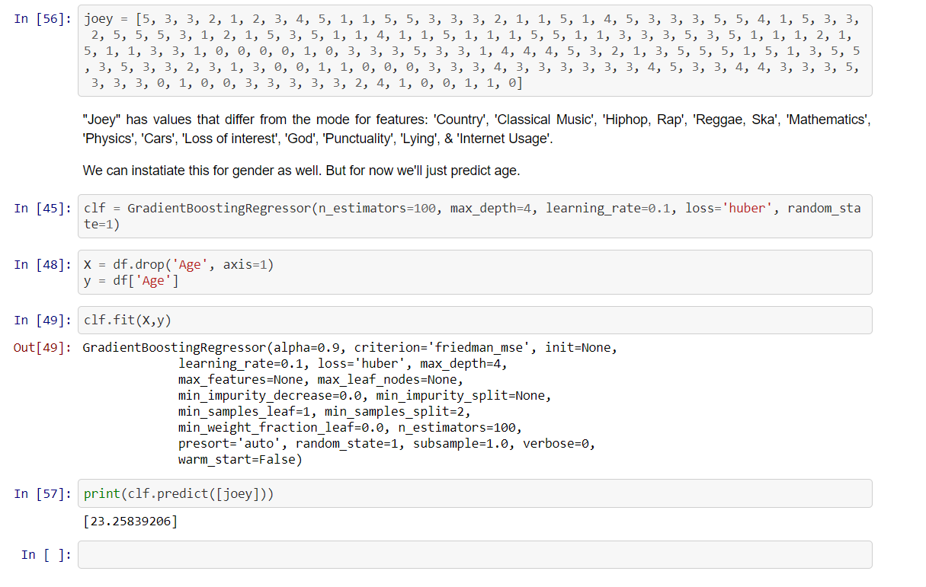
Model Prediction – “Joey”

Slide 16
Shortcomings of the data
Low observations at low and high ages
  Highly recommend a more equal sampling
Data gathered regionally
  Use the Internet to widen the input
  Socioeconomic environment should be accounted for
Possibility of loss in translation
  Not known to be a problem, but worth considering
Would benefit from ordinal questions

Slide 17
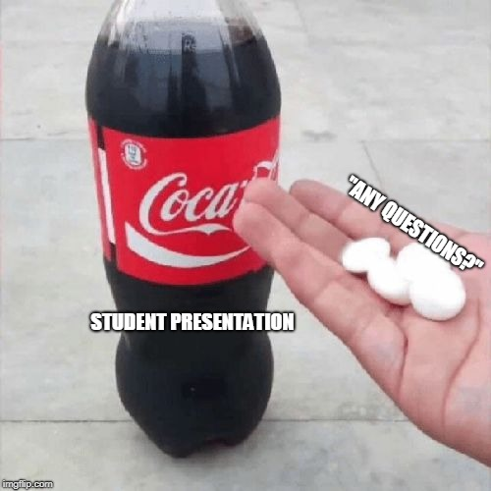
Thank you for your time!
Github Repo: https://github.com/mikess314/Thinkful-Unit-3-Capstone

